Slide 1
March 2010
Project: IEEE P802.15 Working Group for Wireless Personal Area Networks (WPANs)
Submission Title: [ISM and Worldwide Band Modulation for Mandatory 50kbps ]
Date Submitted: [March, 2010]
Source: [Jeritt E. Kent] Company [Analog Devices, Inc.]
[Charles Millet, Conor O’Mahony] Company [Analog Devices, Inc.]
Address [2620 West Regan Avenue, Boise, Idaho 83702]
Voice: [+208 6294580], E-Mail:[jeritt.kent@analog.com]
Re: []
Abstract: [Supporting presentation for 15.4g FSK 50kbps mandatory mode. Background and elaboration.]
Purpose: [Proposed resolution to TG4g comment #324. Presented to the 802.15.4g SUN Task Group for consideration.]
Notice: This document has been prepared to assist the IEEE P802.15. It is offered as a basis for discussion and is not binding on the contributing individual(s) or organization(s). The material in this document is subject to change in form and content after further study. The contributor(s) reserve(s) the right to add, amend or withdraw material contained herein.
Release: The contributor acknowledges and accepts that this contribution becomes the property of IEEE and may be made publicly available by P802.15.
Slide <number>
Jeritt E. Kent (ADI)

Slide 2
Modulation for Mandatory Mode
March 2010
A comment has been made to replace FSK with GFSK for the 15.4g PHY 50kbps mandatory data rate mode, alleging it offers better performance
The argument that GFSK is a better modulation type than FSK for reasons of performance, harmonization, and coexistence is debatable
  FSK can actually offer better performance than GFSK
  Harmonization involves many parameters (data rate, modulation, modulation index, etc.), not just modulation….
  Coexistence is a complex topic, not just a discussion about sidelobes and spurs
    FSK systems can be designed to coexist as well as GFSK systems
Modulation index and tolerance are as important as modulation type
Slide <number>
Jeritt E. Kent (ADI)
Notes:
doc.: IEEE 802.15-<doc#>
<month year>
<author>, <company>
Page <number>

Slide 3
Sensitivity
March 2010
It is standard practice to compare sensitivity numbers for a specific datarate by including the modulation index and, ideally, the receiver IF bandwidth…
Datarate = 50kbps
Modulation | Mod Index | IF bandwidth | Sensitivity (dBm)
FSK | 1 | 100kHz | -107.2
GFSK | 1 | 100kHz | -107.4
FSK | 1 | 150kHz | -107.2
GFSK | 1 | 150kHz | -107
FSK | 0.8 | 100kHz | -107.4
GFSK | 0.8 | 100kHz | -106.9
FSK | 0.8 | 150kHz | -107.2
GFSK | 0.8 | 150kHz | -106.5
FSK | 0.5 | 100kHz | -107
GFSK | 0.5 | 100kHz | -104.6
FSK | 0.5 | 150kHz | -106.8
GFSK | 0.5 | 150kHz | -104.6
Measured Data in the ISM Band 902-928MHz
Here, FSK shows better sensitivity than GFSK for 5 of the 6 profiles…
Slide <number>
Jeritt E. Kent (ADI)
Notes:
doc.: IEEE 802.15-<doc#>
<month year>
<author>, <company>
Page <number>

Slide 4
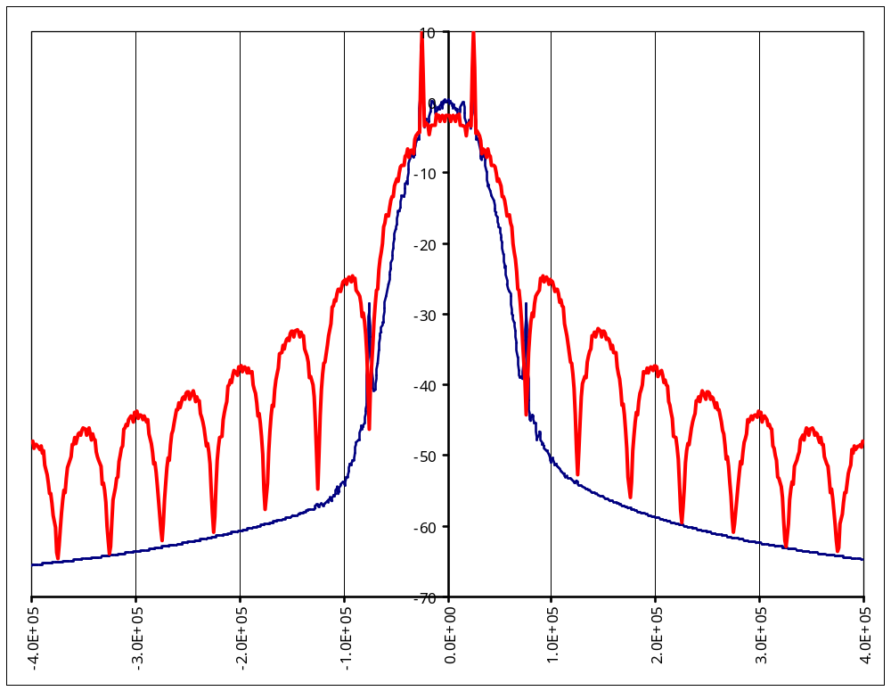
March 2010
Does the FSK spectral mask really look like this when implemented in silicon?
Of Course Not!
Data Rate: 50 kbps
Modulation Index: 1.0
2-FSK
2-GFSK BT=0.5
Simulated Or Drawn data skewed by 5 dB?
From IEEE 802.15-10-0096-01-004g
Slide <number>
Jeritt E. Kent (ADI)
Notes:
doc.: IEEE 802.15-<doc#>
<month year>
<author>, <company>
Page <number>

Slide 5
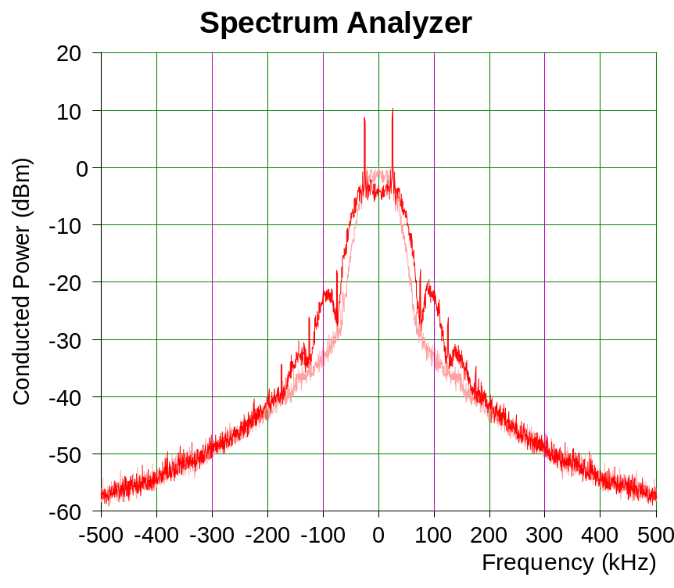
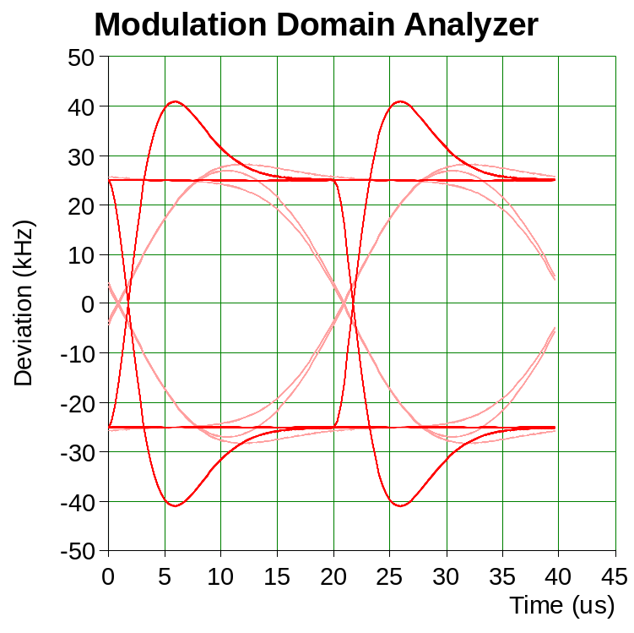
FSK on silicon is not FSK in simulation…
March 2010
  Current FSK radios all incorporate some level of inherent filtering…
    This might be:
      a low pass filter e.g. a Butterworth (maximally flat response) or
      a simple 2 stage RC Filter that replaces a Gaussian Filter
    The low pass filter can be:
      inserted at baseband (we low pass filter the digital bit stream) before FSK modulation or
      it can be done at RF (with the RF Tx PLL Loop bandwidth)
50kbps, h = 1
GFSK (BT = 0.5)
Should we not leave it to the implementers to decide the best ways to meet the spectral mask?
It is not the spirit of the standard to tell implementers HOW to meet the spectral mask.
802.15 .4 normatively states that the transmit mask shall meet local regulations.
FSK
Measured Data in the ISM Band 902-928MHz
Slide <number>
Jeritt E. Kent (ADI)
Notes:
doc.: IEEE 802.15-<doc#>
<month year>
<author>, <company>
Page <number>

Slide 6
Harmonization?
March 2010
What about the fact that the mandatory rate in Japan is 100 kbps?
Should we harmonize the modulation index, too?
For the mandatory rate in the dedicated bands, h = 0.5…
Frequency band
Parameter
Mandatory Data Rate #1
Mandatory Data Rate #2
Optional Data Rate
2400-2483.5 MHz WW
Data Rate
50
100
200
Modulation
GFSK
FSK
GFSK
GFSK
Modulation Index
1
0.5
0.5
Channel Spacing
200
400
400
902-928 MHz ISM
Data Rate
50
100
200
Modulation
FSK
GFSK
GFSK
GFSK
Modulation Index
1
0.5
0.5
Channel Spacing
200
400
400
863-870 MHz Europe
Data Rate
50
100
200
Modulation
GFSK
GFSK
GFSK
Modulation Index
1
1
1
Channel Spacing
200
400
400
There seem to be no technical reasons to change the modulation type used by the majority to match the 863-870MHz band.
Slide <number>
Jeritt E. Kent (ADI)

Slide 7
Gaussian Filtering, A Time Domain View
Gaussian filtering introduces ISI.
ISI reduces performance by closing the eye
  20%
This manifests itself as a reduction of sensitivity and consequently reduces range
10
5
0
-5
-10
-0.5
0
0.5
Slide <number>
Notes:
doc.: IEEE 802.15-<doc#>
<month year>
<author>, <company>
Page <number>

Slide 8
Modulation Index Tolerance
March 2010
In order to allow low cost radio designs, it is common to see modulation index tolerances on the order of the +/- 20% currently specified in 15.4g
Bluetooth, for example, specifies h = 0.28 to 0.35
802.15.4d (Japanese 950MHz band) specifies +/- 30%!
As the modulation index:
h +/- Δh = 2*f_{dev} / DR
for a fixed datarate changes, the deviation frequency and, hence, GFSK performance and sensitivity will vary, too…
  FSK systems can be designed to have much lower ISI than GFSK systems, hence sensitivity is not as much a function of modulation index
Slide <number>
Jeritt E. Kent (ADI)

Slide 9
Variations in modulation indexes adversely affect GFSK
March 2010
Datarate = 50kbps
Modulation | Mod Index | IF bandwidth | Sensitivity (dBm)
FSK | 1 | 100kHz | -107.2
GFSK | 1 | 100kHz | -107.4
FSK | 1 | 150kHz | -107.2
GFSK | 1 | 150kHz | -107
FSK | 0.8 | 100kHz | -107.4
GFSK | 0.8 | 100kHz | -106.9
FSK | 0.8 | 150kHz | -107.2
GFSK | 0.8 | 150kHz | -106.5
FSK | 0.5 | 100kHz | -107
GFSK | 0.5 | 100kHz | -104.6
FSK | 0.5 | 150kHz | -106.8
GFSK | 0.5 | 150kHz | -104.6
Measured Data in the ISM Band 902-928MHz
~3dB!
Modulation index tolerance is currently specified in 15.4g as +/- 20%...
FSK sensitivity only varies about 0.3dB from h = 0.5 to 1.0…
Slide <number>
Jeritt E. Kent (ADI)

Slide 10
Coexistence is Complex
March 2010
  Coexistence depends on differences in frequency, time, space, modulation or coding or a combination of these
  Coexistence depends on topologies and operating conditions of networked nodes in the impacted frequency band
  Coexistence depends on parameters such as peak power, modulation type, modulation index, receiver threshold, propagation channel, inter-nodal spacings and distances, etc.
  Spectral efficiency must include TIME in terms of how long the piece of spectrum is being used - not just the amplitude of the spectral plot!
  A coexistence analysis will be conducted by 802.19; the analysis has not yet begun.
  FSK systems can be designed to co-exist as well as GFSK systems
Slide <number>
Slide <number>
Jeritt E. Kent (ADI)
Notes:
doc.: IEEE 802.15-<doc#>
<month year>
<author>, <company>
Page <number>

Slide 11
FSK is a better option than GFSK for .4g
March 2010
  FSK has equal or superior sensitivity compared to GFSK
  FSK presents lower ISI compared to GFSK
  FSK has negligible variation in sensitivity as a function of modulation index compared to GFSK
  FSK is currently deployed in utility applications at much higher volumes than GFSK…
  Current FSK radios all incorporate some level of inherent filtering which assists the spectral purity of FSK with lesser ISI than that of GFSK
  The difference between FSK and GFSK is certainly NOT compelling enough to make a change.
Slide <number>
Slide <number>
Jeritt E. Kent (ADI)
Notes:
doc.: IEEE 802.15-<doc#>
<month year>
<author>, <company>
Page <number>

Slide 12
Summary
March 2010
 | FSK | GFSK
Proven in the Field for (>=50kbps) Utility Applications (Volumes > 5Mu) | ☺
Best overall sensitivity | ☺
Lowest variation in sensitivity to changes in mod index | ☺
Lowest Intersymbol Interference (ISI) | ☺
Sufficient Spectrally Efficiency given .4g Channel Spacing Definitions (>= 200kHz) and -90dBm Sensitivity Specification | ☺ | ☺
Lowest Complexity & Lower Power (Gas/Water) | ☺
Harmonization of The Mandatory Data Rate | ? | ?
Conclusion | FSK is the best option for .4g with many advantages over GFSK!
The original decision process which selected FSK has been validated – IT WAS THE CORRECT DECISION.
There are certainly no new compelling reasons to undo that decision.
Slide <number>
Slide <number>
Jeritt E. Kent (ADI)
Notes:
doc.: IEEE 802.15-<doc#>
<month year>
<author>, <company>
Page <number>

